Slide 1



TEXT COMPRESSION USING HUFFMAN CODING ALGORITHM FOR EFFICIENT DATA STORAGE AND TRANSMISSION
PROJECT MEMBER
SANJAY N(23ALR087)
ROHAN PRABAKAR V (23ALR079)
SANTHOSH K (23ALR089)

Slide 2
PROBLEM STATEMENT
With the growing volume of digital data, efficient storage and transmission are essential.
Text data often contains repetitive characters, making it suitable for compression.
This project aims to implement Huffman Coding to reduce text file sizes by assigning shorter codes to frequent characters, ensuring efficient, lossless compression.
The solution will include encoding and decoding mechanisms to verify data accuracy and demonstrate improved storage and transmission efficiency.

Slide 3
OBJECTIVE
The objective of this project is to implement the Huffman Coding algorithm to compress text data by assigning optimal binary codes to characters based on their frequency.
This compression technique aims to reduce the storage space required for text files and enhance data transmission efficiency.
By achieving a smaller file size without losing information, this project demonstrates how Huffman Coding can be used effectively for data compression in real-world applications, such as file storage, network transmission, and multimedia compression.

Slide 4
ALGORITHM
Input: text
Create frequency dictionary for each character
Insert each character with frequency into min-heapWhile more than one node in heap:
Remove two nodes with lowest frequencies
Create a new node with combined frequency, set as parent
Insert new node back into heap
Recursive function generate_code(node, current_code):
If leaf node, store code Else, traverse left (add "0") and right (add "1")Call generate_code on root with "For each character in text, replace with Huffman code
For each bit in encoded text, traverse tree to retrieve characters
Output codes, encoded text, and decoded text (if verifying)

Slide 5
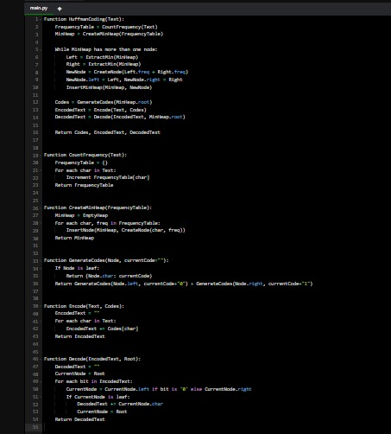
PSEUDOCODE

Slide 6
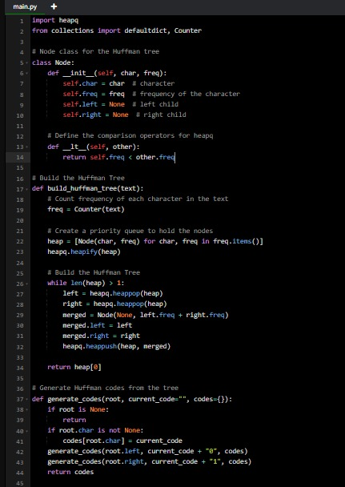
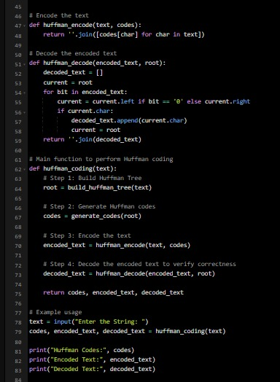
IMPLEMENTATION

Slide 7
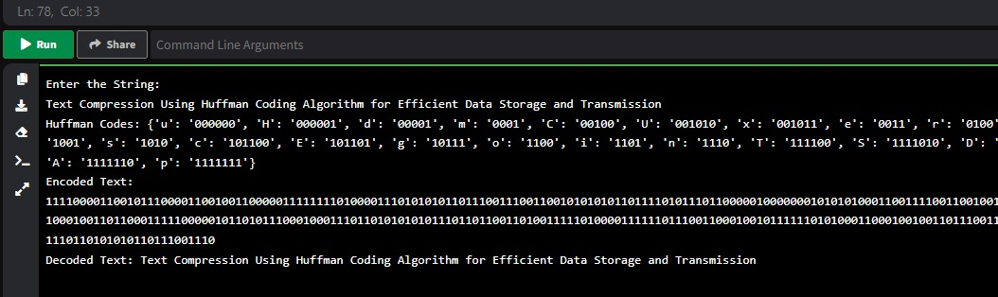
OUTPUT

Slide 8
CONCLUSION
This project shows how Huffman Coding efficiently compresses text data by assigning shorter binary codes to frequent characters, resulting in reduced file sizes and faster data transmission. The solution supports both encoding and decoding, ensuring accurate data reconstruction. Huffman Coding’s practical use in file compression and data transfer highlights its value in optimizing digital data storage.

Slide 9
THANK YOU

